Slide 1

Participatory Assessments with Children and Youth with Disabilities
What steps will we undertake?

Slide 2
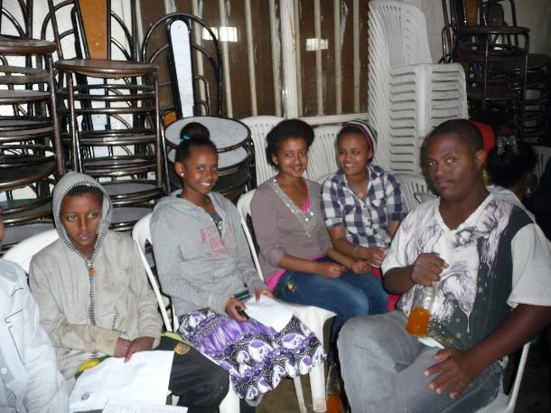
Information session –
Getting to know each other

Slide 3
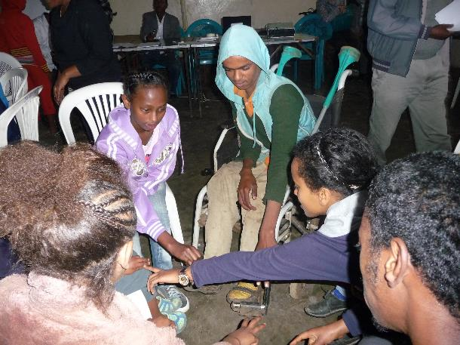
Information session –
Getting to know each other

Slide 4
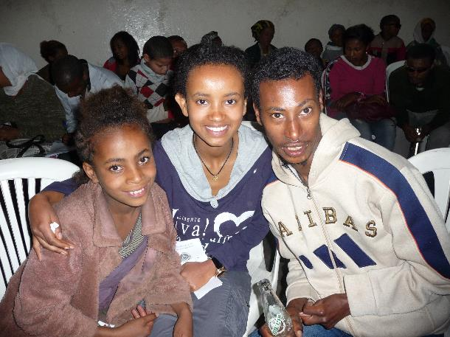
Information session –
Getting to know each other

Slide 5
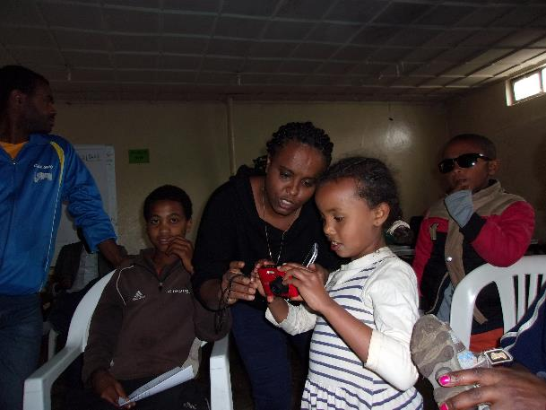
Information session – Introducing activities

Slide 6
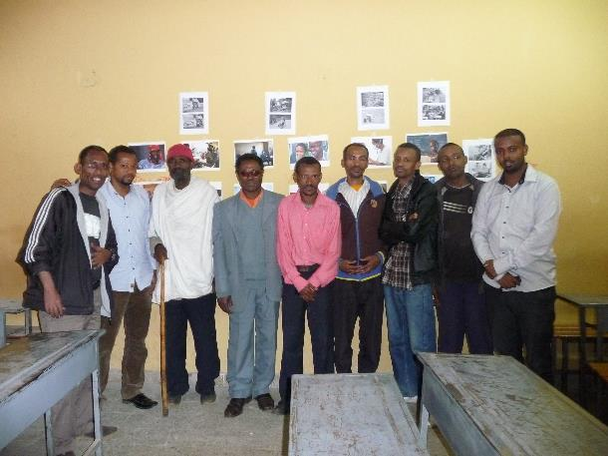
Group discussions –
Fathers of children with disabilities

Slide 7
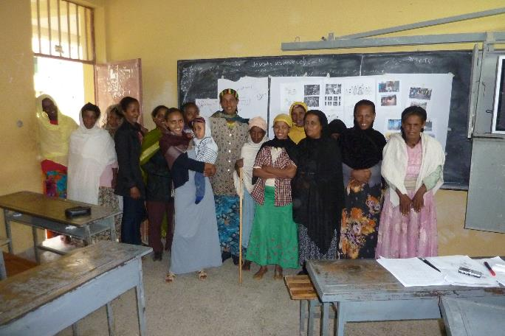
Group discussions –
Mothers of children with disabilities

Slide 8
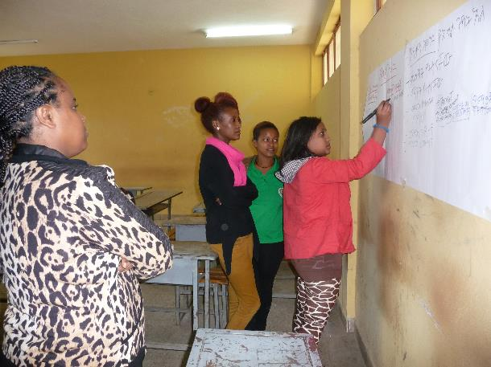
Group discussions – Girls who are care-givers

Slide 9
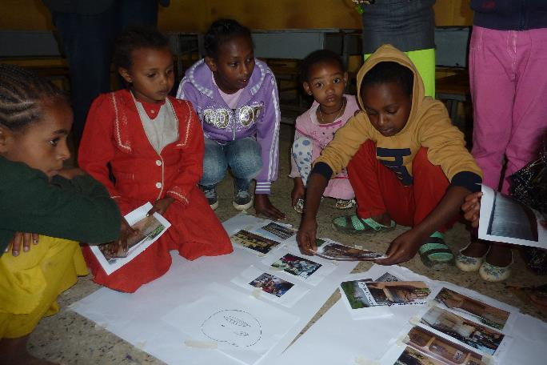
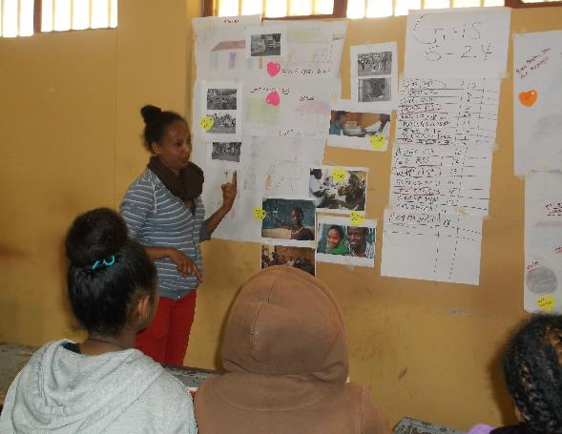
Participatory activities - Girls and young women with and without disabilities

Slide 10
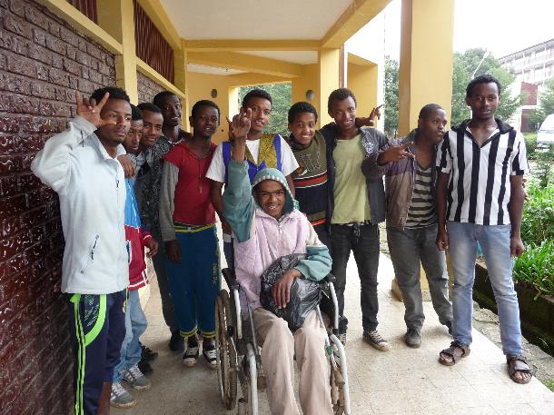
Participatory activities – Boys and young men with and without disabilities

Slide 11
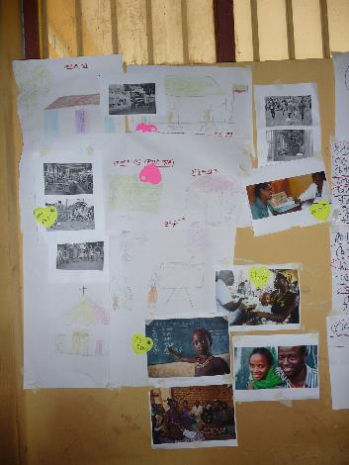
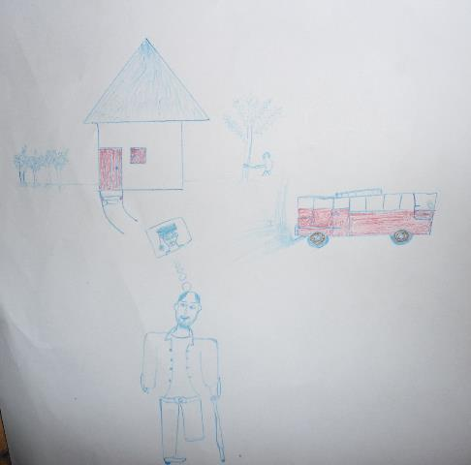
Participatory activities –
Drawing and picture library

Slide 12
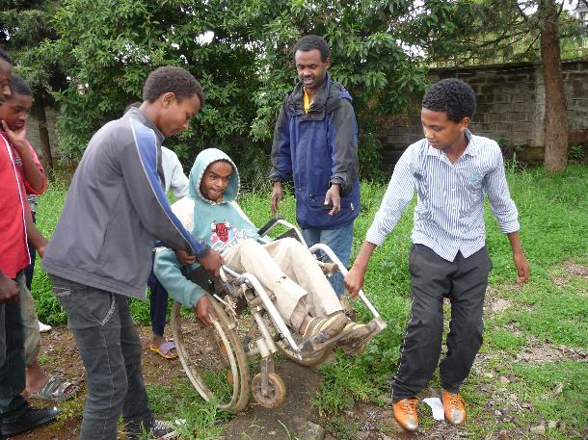
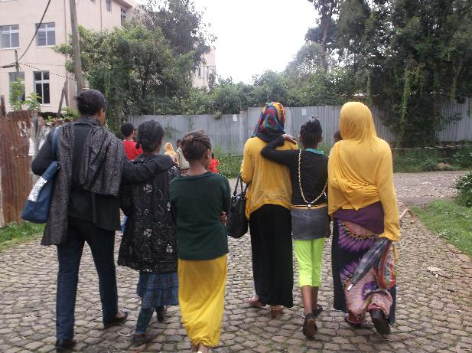
Participatory activities – Guided tour

Slide 13
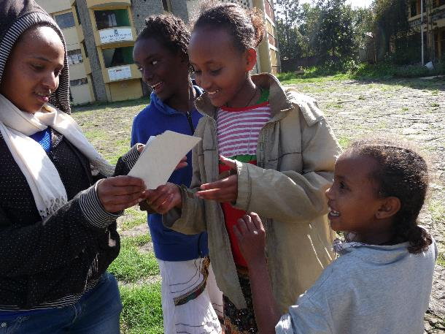
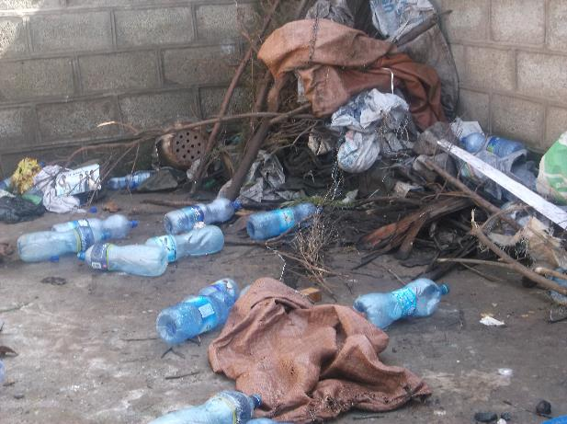
Participatory activities – Photography

Slide 14
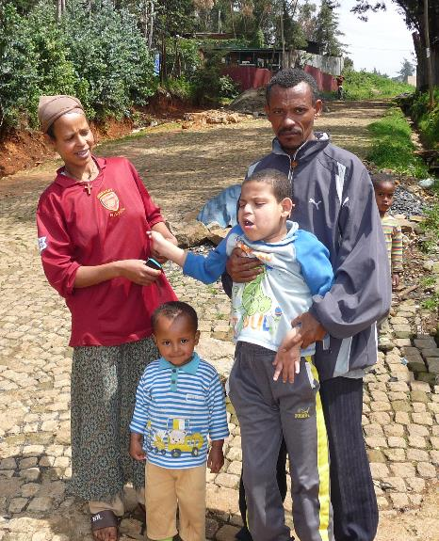
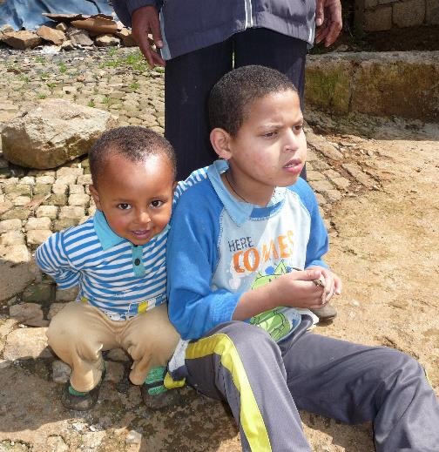
Interviews and home visits

Slide 15
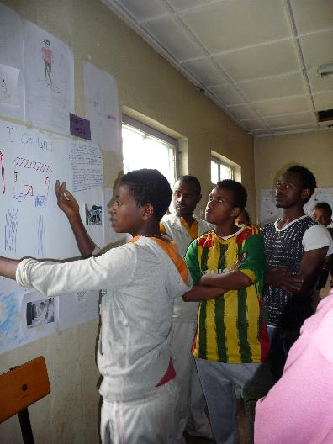
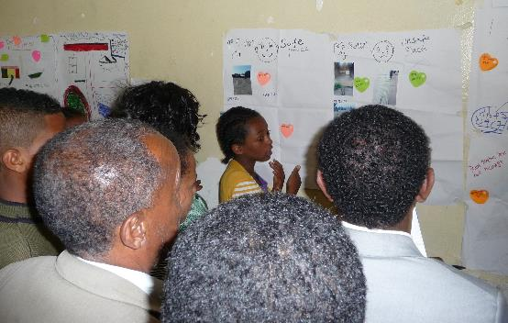
Community workshop – Presenting ideas

Slide 16
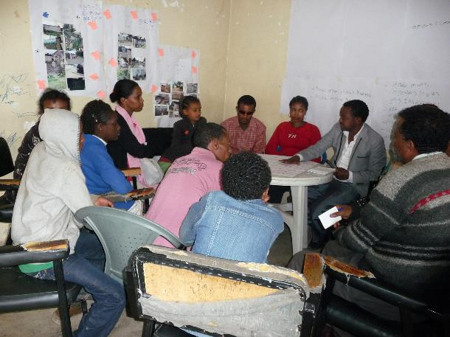
Community workshop –
Planning with stakeholders

Slide 17
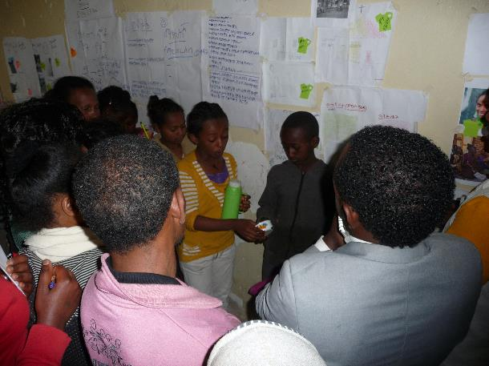
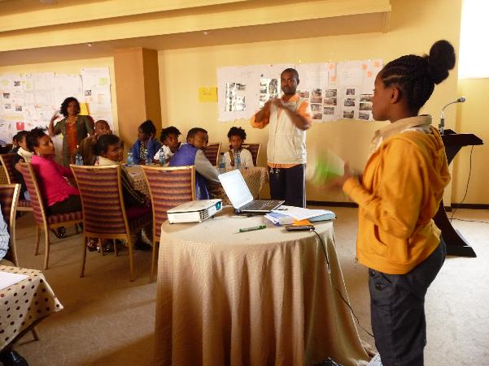
Teaching others

Slide 18
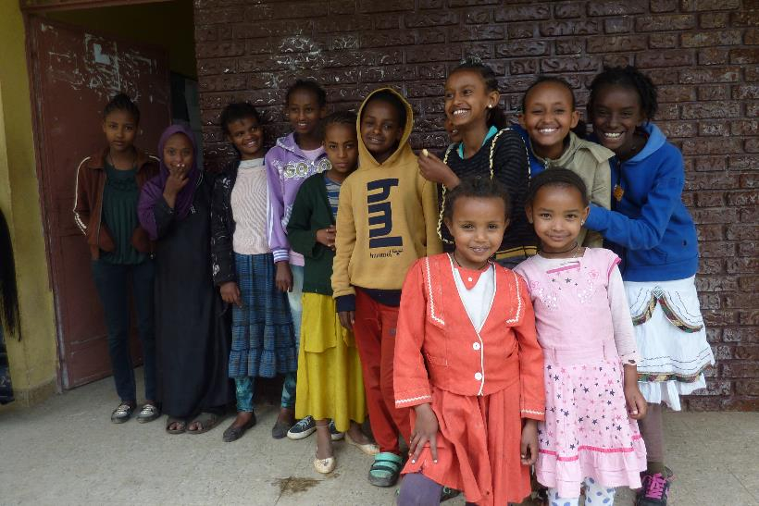

Slide 19
For more information, please contact:
Emma Pearce – Women’s Refugee Commission
EmmaP@wrcommission.org
Danielle Roth – ChildFund International
DRoth@ChildFund.org

