Slide 1



Practical Tools for Integrating Cash and Gender-based Violence (GBV) Programming
Webinar
March 20th, 2018
Notes:
This webinar is brought to you by the Women’s Refugee Commission, the International Rescue Committee and Mercy Corps with support from the U.S. Department of State’s Bureau of Population, Refugees and Migration.

Slide 2
Presenters
Tenzin Manell
Senior Technical Advisor, Cash and Livelihoods
Kevin McNulty
Senior Protection Advisor
Melanie Megevand
Women & Girls’ Safe Space Specialist

Slide 3
Outline
Background – project and partnership
Taking stock of current practice integrating cash and GBV programming
Introduction and orientation to the Toolkit
Programmatic and operational learning from piloting the Toolkit in Jordan
Calls to Action for cash actors, GBV actors and donors
Q & A

Slide 4
Background: Project & Partnerships
WRC funded by U.S. Bureau of Population, Migration and Refugees
Goal: build capacity of humanitarian actors to optimize Cash-based Interventions (CBIs) for enhanced protection from GBV
  Assessed current practice
  Developed guidance & tools
  Piloted field resources in 3 settings
    Jordan with Mercy Corps & IRC
    Somalia with African Development Solutions
    Niger with Save the Children
Notes:
WRC recently completed a 17-month action research project funded by the United States Bureau of Population, Refugees and Migration to build the capacity of humanitarian actors to optimize CBIs for enhanced protection from GBV. This project helps realize key actions within the Call to Action on Protection from GBV in Emergencies, specifically, strengthening needs assessments and integrating GBV across sectors). In addition, the Cash Learning Partnership’s global framework for Action (specifically, improving the quality of cash based interventions).
WRC:
-assessed current practice on the integration of cash and GBV programming humanitarian settings
- jointly developed guidance and tools with Mercy Corps and IRC
-piloted these field resources in 3 humanitarian settings.

Slide 5
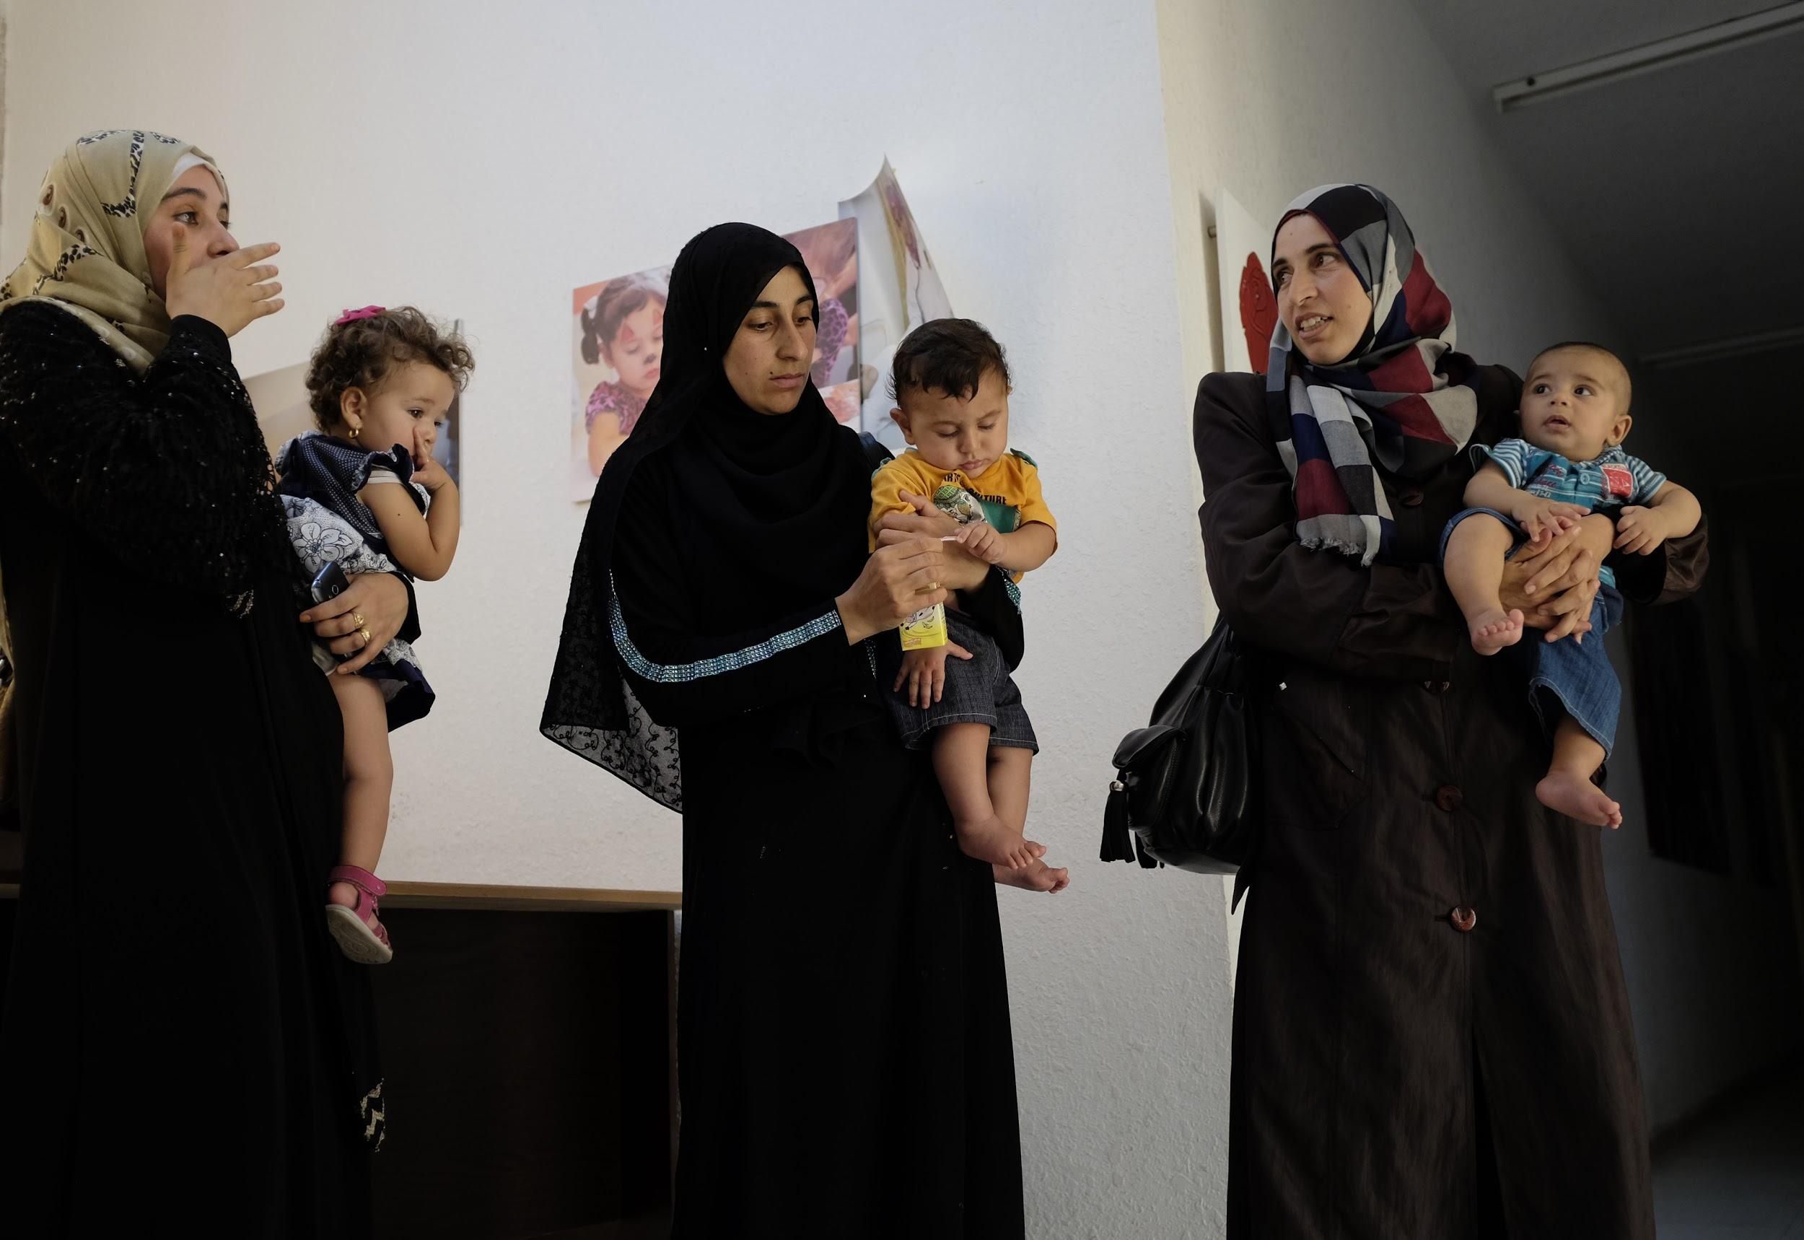
Mercy Corps & IRC Partnership
Strengthen coordination to address GBV & develop evidence for best practice
Address limitations & opportunities of coordination & referrals for utilizing cash within GBV case management
Notes:
In parallel to this project IRC and Mercy Corps have an ongoing partnership.
Recognizing gaps in practice re: mainstreaming GBV considerations in CBIs and integrating CBIs into GBV programming, IRC and Mercy Corps signed an MoU in May ‘2017
Mercy Corps committed to referring cases to IRC for GBV and health services, in particular sexual and reproductive health services.
IRC committed to refer cases to Mercy Corps to receive cash-for-documentation assistance according to Mercy Corps criteria, whenever IRC is not able to provide the service.

Slide 6
Taking Stock of Current Practice
Integrating cash and GBV programming is the next frontier
Cash and GBV actors are siloed
Prevailing anxiety about integrating cash and GBV programming inhibit cash and GBV actors from working together
Notes:
WRC conducted 40 interviews with cash and GBV experts across 20 agencies to assess how cash and GBV programming are integrated in humanitarian settings globally. I want to share with you this morning key findings from our research.
While there has been progress on cash and protection, tackling the integration of cash and GBV programming is the next frontier.
A number of resources are out there on cash and protection, for example, the Guidance on Protection in Cash-based Interventions and the accompanying tool and training. Institutionalization efforts have taken place. But we still need to dig further into the integration of cash and GBV. Momentum is picking up.
2. Cash and GBV actors are siloed within agencies and across communities of practice, impeding clarity on roles and responsibilities, the development of successful approaches, and effective coordination efforts;
3. Prevailing anxiety about integrating cash and GBV programming inhibits actors from building the required skills to collaborate effectively, and the evidence to move forward. Despite evidence that cash itself is not risky, there’s still apprehension amongst some donors and practitioners. While there is buy-in for mainstreaming GBV considerations into cash-based interventions, there is hesitancy about utilizing cash as a tool within GBV case management. However, nascent programming and good practice exists.

Slide 7
Taking Stock of Current Practice (cont’d)
Resource gaps are challenges to generating learning and building evidence
Persistent poor practice undercuts the potential of cash
Cash and GBV practitioners need practical field resources
Notes:
4. Resource gaps, including donor funding and staffing, are challenges to generating learning and building evidence;
We need longer term project horizons and longer-duration cash assistance, in particular, to support the recovery of GBV survivors.
5. Persistent poor practice undercuts the potential of cash:
-Despite being recognized as best practice, there is a persistent lack of gender and protection analysis – these analyses are rarely integrated;
-“One-size-fits-all” programming is pervasive despite evidence that cash needs to be tailored to meet specific needs and ensure protection;
-We are missing opportunities left and right to pair cash with complementary activities and services for gender-transformative and protective outcomes;
-Cash staff are often untrained in the basics of gender and rarely in protection –even more rarely in GBV prevention and response;
-GBV staff are often untrained in the basics of cash programming;
-It’s common-place that GBV referral pathways are unestablished or underutilized.
6. Cash and GBV practitioners need practical field resources for staff capacity building, assessments, and monitoring. There is demand for adaptable and modular field resources to capture the requisite information on protection risks and benefits associated with cash. Practitioners are hungry for guidance and tools that help them deepen the activities they are already doing.

Slide 8
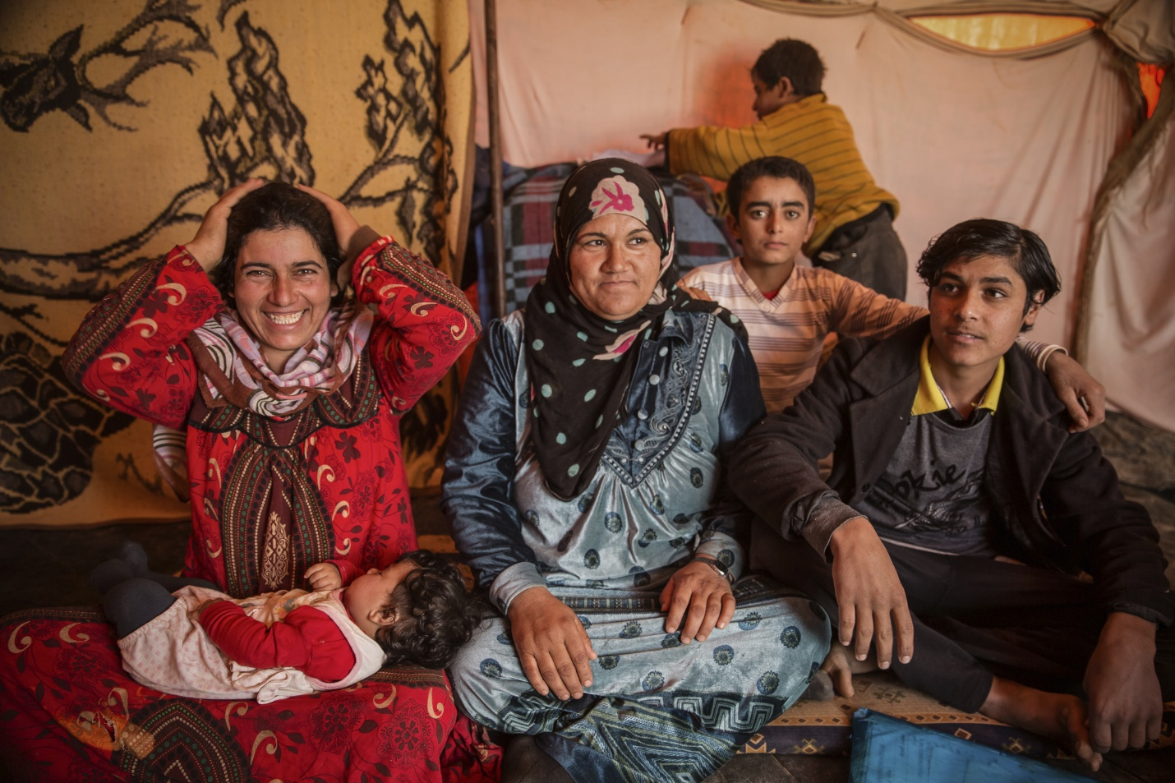
Toolkit for Optimizing Cash-based Interventions for Protection from Gender-based Violence:
Mainstreaming GBV Considerations in CBIs and Utilizing Cash in GBV Response
Notes:
This toolkit assists practitioners in collecting the requisite situational protection information on risks for affected populations with an age, gender, and diversity (AGD) lens, identifying community-based or self-protection mechanisms, informing tailored and protective cash-based interventions, and preparing a monitoring system that is based on identified protection risks.

Slide 9
Toolkit Structure
Section I: Mainstreaming GBV Considerations in CBIs
2 Tools (T)
Section II: Integrating Cash into GBV Case Management
1 Protocol (P)
2 Guidance Notes (G)
1 Tool (T)
1 Guidance Note (G)
Notes:
The toolkit has two sections
Section I is for cash practitioners and includes 2 tools and 2 guidance notes
Section II is for GBV caseworkers and includes 1 protocol, 1 tool and 1 guidance note
Both sections of this toolkit promote collaboration between cash and GBV practitioners to effectively integrate cash and GBV programming

Slide 10
Section I: Mainstreaming GBV Considerations in CBIs
Assessing and Mitigating Risks of Gender-based Violence in Cash-based Interventions through Story: A Focus Group Discussion and Interview Guide (T)
Post Distribution-Monitoring (PDM) Module: Adapting CBIs to Mitigate GBV Risks (T)
Assessing and Mitigating Risks of Gender-based Violence : Guidance for Cash Providers (G)
Section I:
Monitoring and Mitigating Risks of GBV: Guidance for Cash Providers (G)

Slide 11
Section I: Mainstreaming GBV Considerations in CBIs
Assessing and Mitigating Risks of Gender-based Violence in Cash-based Interventions through Story: A Focus Group Discussion and Interview Guide
Assessing and Mitigating Risks of Gender-based Violence : Guidance for Cash Providers
Section I:
http://wrc.ms/cashandgbv-fgd

Slide 12




Assessing and Mitigating Risks of Gender-based Violence in Cash-based Interventions through Story: A Focus Group Discussion and Interview Guide
Context-specific examples of GBV
Sub-population specific, depersonalized stories
Qualitative discussion questions
Referral pathways to access services
Notes:
Assessing and Mitigating Risks of Gender-based Violence in Cash-based Interventions through Story: A Focus Group Discussion and Interview Guide
This tool uses FGDs and qualitative questions to identify any potential risks associated with the introduction of cash assistance. The FGD begins by sharing context-specific examples of GBV. Then depersonalized, sub-population-specific stories are shared followed by qualitative questions about the characters in the story.
Aim: to assess potential risks of GBV associated with a CBIs, as well as risk mitigation mechanisms to ensure safe receipt and use of cash
Accompanying guidance is provided

Slide 13
Programmatic & Operational Learning Assessing Risk
FGDs and Interviews through story
Provided insight into beneficiaries’ perceived risks of GBV associated with the introduction of cash assistance
Gave insight into some potential protective benefits of cash assistance for protection outcomes
Ultimately, provided opportunities to mitigate risks of GBV for beneficiaries of cash assistance
Notes:
Provided insight into beneficiaries’ perceived risks of GBV associated with the introduction of cash assistance
Women and girls:
Increased exposure to domestic violence (e.g., discussions on how to spend the cash transfer trigger incidents);
Denial of resources (e.g., the cash would be reinvested in the man’s income-generating activity rather than the woman’s);
Harassment from the host community as well as other refugees when collecting the cash transfer;
Increase in early marriage associated with an increase in household income and social status;
Social tension amongst Syrians and Jordanians (in situations when only refugees were provided cash transfers);
Risk of theft.
Gave insight into some potential protective benefits of cash assistance for protection outcomes
Women and girls:
Increased status within the household, and relatedly, an increased confidence to report GBV;
Enrollment of girls in school;
Self-reported reduced exposure to domestic violence, including physical violence (e.g., because women would ask their husbands for money less frequently in order to meet basic needs);
Reduction of risky income-generating activities;
Reduction of interhousehold violence linked to debt and loan repayment
Provided opportunities to mitigate risks of GBV for beneficiaries of cash assistance

Slide 14
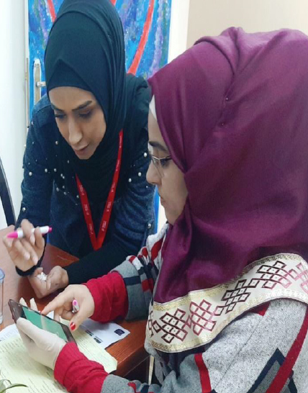
Adapting Programming
Outputs
Introduced “Mobile Wallet” for female heads of households (FHH) to minimize visibility.
Process
Took more time with clients
Changed delivery time for FHH
Assigned a GBV focal person with team
Training in GBV (esp. available services and referral pathways)
Notes:
Out puts
Diversifying delivering systems such as introducing mobile wallet
Process
Training to cash staff on GBV, Gender, Referral Pathways, assigning GBV focal point for additional follow up with GBV cases
More engaging with clients and giving them more time. Flexibility with client, listening, client-centered

Slide 15
Section I: Mainstreaming GBV Considerations in CBIs
Post Distribution-Monitoring (PDM) Module: Adapting CBIs to Mitigate GBV Risks
Section I:
Monitoring and Mitigating Risks of GBV: Guidance for Cash Providers
http://wrc.ms/cashandgbv-pdm-sectioni

Slide 16
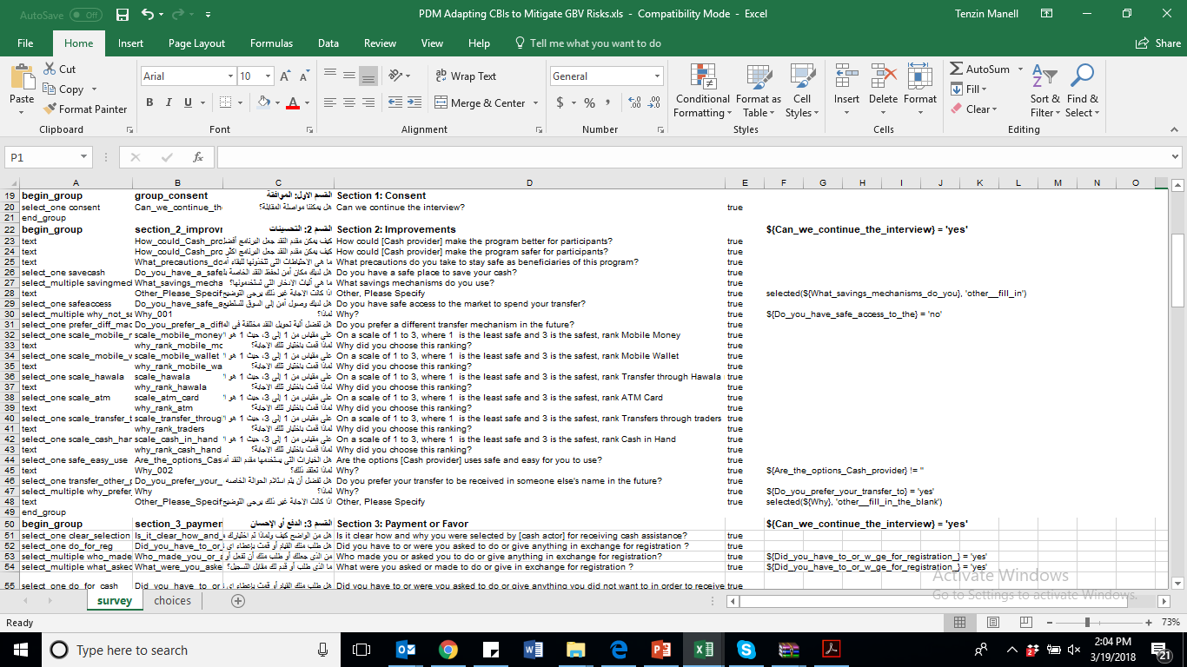
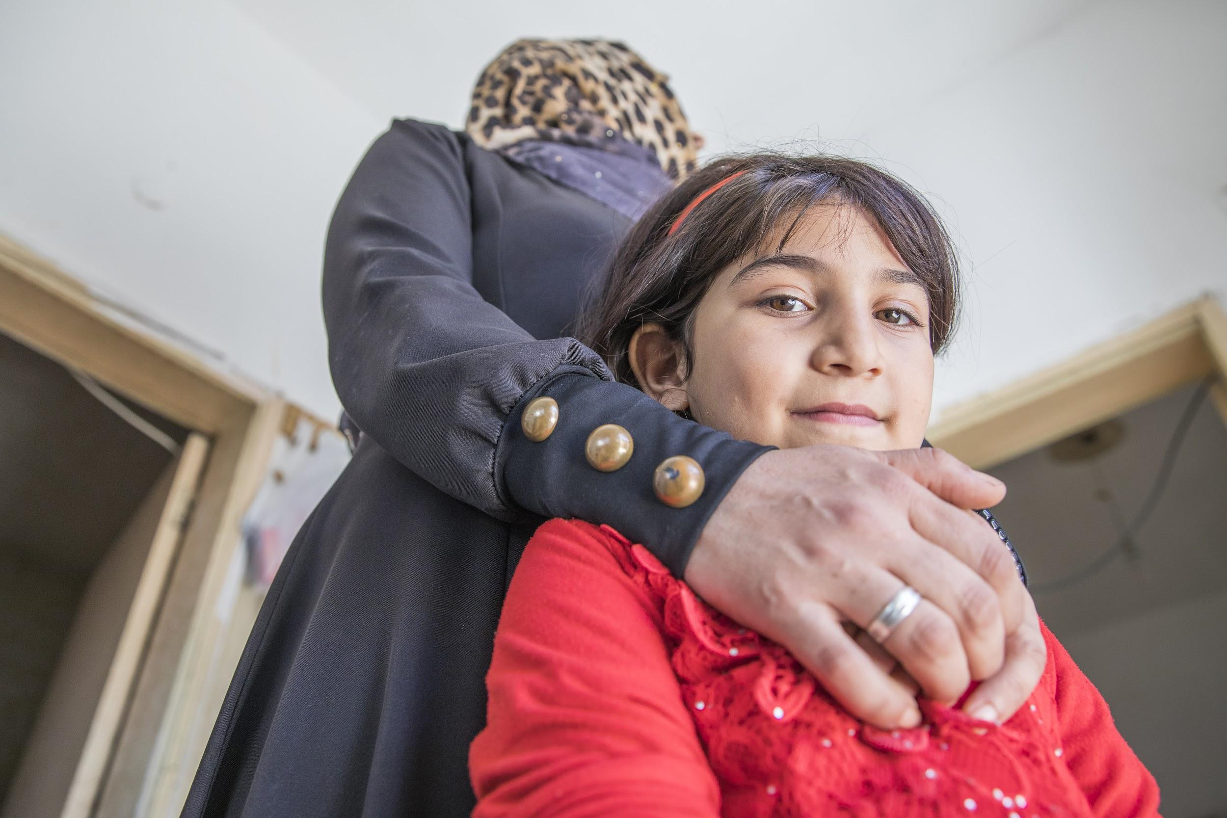
Post Distribution-Monitoring (PDM) Module: Adapting CBIs to Mitigate GBV Risks
Notes:
Post Distribution-Monitoring (PDM) Module: Adapting CBIs to Mitigate GBV Risks
Aim: To bridge gaps and ensure that any protection risks identified during assessment are monitoring during implementation.
Tool is modular
Includes qualitative questions
Accompanying guidance is provided.

Slide 17
Programmatic & Operational Learning Post Delivery Monitoring
Benefits
Were recipients able to use cash for issues (ie rent, food security, access to health, etc.) that had previously put them at risk?
What were there additional protection benefits?
Risks
Did recipients note increased risks to their safety, as a result of receiving cash?
And, how prevalent was safety a concern among the recipient to determine how to adapt? (stopping, broad adaptation to the delivery system, catered to individuals)
Notes:
Benefits
Were recipients able to use cash for issues (ie rent, food security, access to health, etc.) that had previously put them at risk?
94% reported that the cash transfer positively impacted relations within their household, highlighting that cash helped with the household’s rent security, food security, and access to the health services status.
Allowed parents to send their children to school.
Cash assistance would likely reduce the number of female child marriages and improve school retention
Risks
Did recipients note increased risks to their safety, as a result of receiving cash?
And, how prevalent was safety a concern among the recipient to determine how to adapt? (stopping, broad adaptation to the delivery system, catered to individuals)
4% reported increased tension among members of the household or community, most of the respondents that reported increased tension were female heads of households

Slide 18
Section II: Integrating Cash into GBV Case Management
Section II
Protocol for GBV Case Workers for Assessing Survivors’ Financial Needs and Referring Clients of GBV Case Management for Cash Assistance (P)
Post-distribution Monitoring (PDM) Module for Cash Referrals for Survivors of Gender-based Violence (T)
Guidance for GBV Case Management Services on Monitoring Cash Referrals for Survivors of Gender-based Violence (G)

Slide 19
Section II: Integrating Cash into GBV Case Management
Section II
Protocol for GBV Case Workers for Assessing Survivors’ Financial Needs and Referring Clients of GBV Case Management for Cash Assistance
http://wrc.ms/cashandgbv-protocol
Notes:
Protocol for GBV Case Workers for Assessing Survivors’ Financial Needs and Referring Clients of GBV Case Management for Cash Assistance
– This tool builds on IRC’s innovative work in Jordan since 2012 on integrating cash assistance into its GBV response and prevention programming in urban displacement settings and through this project IRC has been very grateful for the opportunity to collaborate with WRC and MC to review and adapt it for use in broader humanitarian contexts and populations.
This tool follows the global inter-agency GBV case management guidelines for caseworkers as the overarching framework, but this protocol offers to caseworkers guidance on key considerations and approaches GBV case workers can use in each step of case management to integrate cash assistance within their case management with clients (which does not exist in the current inter agency guidelines)

Slide 20
Programmatic Learning - IRC
BENEFITS
Cash in tandem with GBV case management can be flexible & life-saving;
Cash & WPE soft services instead of only cash promotes protection & resilience;
Combing cash & mixed gender discussion groups can:
  -Decrease domestic violence
  -Extend the protective aspect of cash beyond the distribution period.
RISKS
Targeting women as recipients can be seen to undermine men’s power & place women at risk of violence;
Cash can contribute to social tensions between refugees & host communities;
Cash without protection activities limits potential to mitigate GBV;
Standard transfer amount & duration can limit responsiveness to specific needs and/or sustainable solutions.
Notes:
1st phase learning for IRC began earlier in 2015 through UNHCR and European Commission Humanitarian Aid and Civil Protection Department’s Enhanced Response Capacity funding- IRC was a learning partner through case study “Improving Cash-Based Interventions Multipurpose Cash Grants and Protection: Integrating Cash Transfers into Gender Based Violence Programs in Jordan: Benefits, Risks and Challenges”
Existing literature on cash and protection in humanitarian contexts
IRC’s program-related documentation
FGDs (with 72 cash and non-cash male and female beneficiaries)
Individual interviews (with five female cash beneficiaries, 14 IRC staff, and external protection stakeholders).
2nd phase learning : April 2017 rapid assessment through this project and partnership with WRC + MC
targeting 496 respondents, taking into consideration gender-, age-, and nationality-disaggregated data
Establish a baseline understanding of the social and cultural norms, in particular as related to the stigma faced by survivors of GBV, as well as related protection risks.
Findings were the same between the two learning opportunities

Slide 21



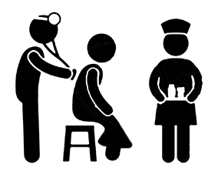


Protocol for GBV Case Workers for Assessing Survivors’ Financial Needs and Referring Clients of GBV Case Management for Cash Assistance
Intake Consultation with GBV caseworker
Assess ; Action Plan ; Safety Plan caseworker and client asses needs, decide on a plan to respond to the client’s needs & ensure the client’s safety
Referral for CBI caseworker initiates referral based on agreed protocol with CBI partner
Access to services or cash
as identified in client’s action plan
PDM / case follow up
Assess benefits and risks and next steps
Notes:
This tool includes guidance for caseworkers on how to:
1 - contextualize the incident the survivor discloses and assess the survivors’ needs for cash assistance within an understanding of their access to and control over resources to understand how lack of access to or control over may trigger or aggravate incidents or violence or prevent clients from accessing the necessary services to recover and mitigate further harm
2 - How to determine with the client if cash (alongside regular case management services) is able to 1) offer immediate lifesaving support 2) ensure access to response services which otherwise would not be accessible to the survivor due to prohibitive costs or their inability to access and or control the use of resources without compromising someone else knowing their experience (i.e. in order to access the cash they would have to ask from someone who would likely ask or know why and this could place them at further harm) 3) mitigate an imminent incident of violence from occurring
3 – How to conduct an action plan with the survivor including if cash is an option (i.e. action plan can have as one action to receive the cash + how the cash will contribute to another action of the plan)
4 – how to conduct specific safety plans with the survivor if cash assistance is determined a part of their plan (i.e. this is different / in addition to a safety plan caseworkers conduct with IPV survivors and is more like in section 1 tools ensuring that cash does not further contribute to placing the survivor at risk of harm)
5- how to work with cash colleagues (whether internal or external) to tailor the cash assistance to meet the timely needs of survivors and uphold the guiding principles and ethical considerations of working with survivors of GBV (i.e. believing the survivor ; confidentiality / need to know basis ; consent etc) , and
6 – sample script for how to communicate to GBV survivors about cash referrals.

Slide 22
Section II: Integrating Cash into GBV Case Management
Section II
Post-distribution Monitoring (PDM) Module for Cash Referrals for Survivors of Gender-based Violence
Guidance for GBV Case Management Services on Monitoring Cash Referrals for Survivors of Gender-based Violence
http://wrc.ms/cashandgbv-pdm-sectionii

Slide 23
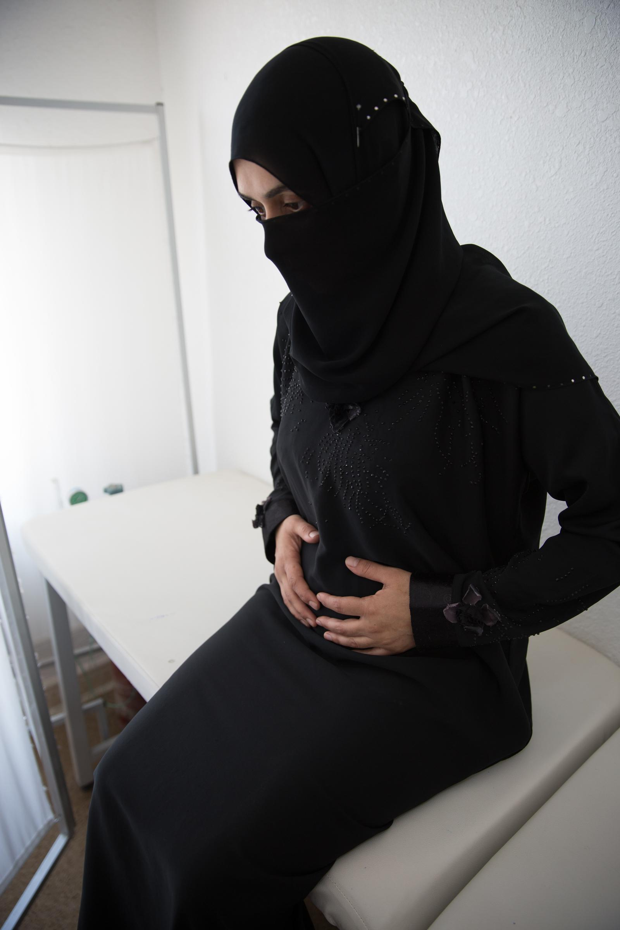
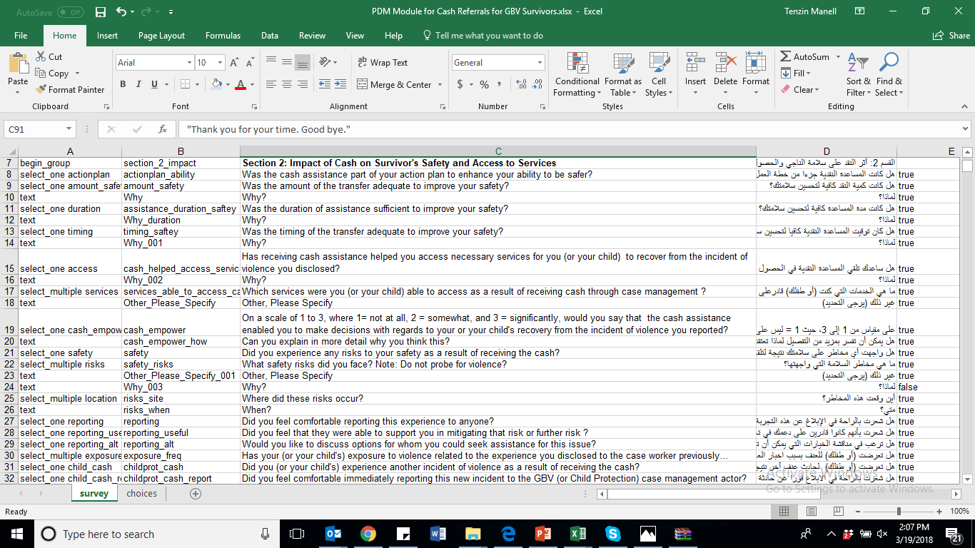
Post-distribution Monitoring (PDM) Module for Cash Referrals for Survivors of Gender-based Violence
Notes:
Post-distribution Monitoring (PDM) Module for Cash Referrals for Survivors of Gender-based Violence.
All caseworkers are responsible for ensuring if the client’s support system is functioning effectively and the services received have / are fulfilling its intended purpose during the case follow up step
This tool helps GBV caseworkers and their supervisors to directly monitor protection risks and the specific GBV response benefits associated with cash assistance in the case management process and the effectiveness of risk mitigation mechanisms;
The data points are to be decided on also with the cash partner as those data points will be shared with the cash partner (whether internal or external) to inform their own reporting and monitoring of cash.
This PDM is meant to inform adaptations in cash referrals to address barriers to achieving case action goals and to maximize protection outcomes and provides a frame for coordination between the case management and cash actors.
Guidance for GBV Case Management Services on Monitoring Cash Referrals for Survivors of Gender-based Violence. Accompanies the PDM tool and provides guidance on how to action and coordinate the information gained through the PDM to inform both case specific and potentially broader programming implications for the cash and case management actors

Slide 24
Programmatic & Operational Learning - IRC
SURVIVORS RECEIVING CASH FOR
BASIC NEEDS ASSISTANCE
90% confirmed cash reduced their exposure to violence of which 50% reported violence ceased
8% reported violence increased after cash, attributed to
  untimely transfers
  Insufficient transfer amount
SURVIVORS RECEIVING CASH
FOR EMERGENCY RESPONSE CASES
All survivors were involved in case assessment & safety plan.
100% of cases decreased exposure to violence and improved their sense of safety and empowerment
OPERATIONAL LEARNING:
Cash and GBV case management staff need to be exposed to and trained on key components of each other’s approaches and operational parameters to ensure quality effective support to survivors
In order to uphold the long term safety of survivors need to access
livelihood opportunities to achieve self-reliance beyond the receipt of
cash.
Notes:
Administered Post-distribution Monitoring (PDM) Module for Mainstreaming GBV Considerations in CBIs (developed by Mercy Corps, IRC and WRC)
Sample:
50 female GBV survivors receiving cash for basic assistance in Mafraq, Irbid, and Ramtha
Four female GBV survivors receiving cash for emergency needs in Mafraq and Irbid.
The first operational learning point relates to ensuring the quality and coordinated support to survivors and mitigating against the negative consequences for survivors as represented in the 8% statistic
The second operational learning point relates to the fact that cash is temporary and while essential to support a survivor’s immediate safety and or access to services if they are not able to become self-reliant the risks of violence may likely return
.

Slide 25
Calls to Action: Cash Practitioners
Collaborate with GBV actors to mainstream GBV considerations within CBIs across the program cycle.
Assess, mitigate and monitor risks of GBV associated with the introduction of cash assistance. Tailor and adapt assistance.
Collaborate with GBV actors to integrate cash within GBV case management services.
Notes:
To optimize CBIs for enhances protection from GBV, cash actor must:
Reach out to and collaborate with GBV actors at the field level to mainstream GBV considerations within CBIs throughout the program cycle.
Assess, mitigate and monitor risks of GBV associated with the introduction of cash assistance. They need to tailor programming and adapt programming throughout the implementation phase to ensure safety and inclusion. This may mean adjusting the delivery mechanism, the amount or frequency of cash transfers, pairing cash with other activities and services; and
Partner and collaborate with GBV actors to integrate cash within GBV case management services to holistically meet the protection needs of survivors.

Slide 26
Calls to Action: GBV Practitioners
Set up comprehensive intersectoral referrals –cash actors are just as important as other partners.
Build partnerships to integrate cash within GBV case management services – may require multiple partners to stop-gap access for clients.
Collaborate with cash actors to ensure GBV considerations are mainstreaming within CBIs.
Notes:
GBV practitioners need to:
Establish comprehensive intersectoral referrals, taking into consideration that cash actors are as equally as important as health or other referral partners.
Reach out to cash actors and build partnerships to integrate cash within GBV case management services to better meet the protection needs of clients. Integrating cash into GBV programming may require coordinating with a variety of actors to stop-gap access for clients for whom cash has been identified a key element in their action plan.
Collaborate with cash actors to ensure GBV mainstreaming within CBIs across the program cycle.

Slide 27
Calls to Action: Donors
Incentivize assessment, mitigation & monitoring of risks associated with CBIs.
Dedicate funding streams to the research & scaling the integration of cash assistance into GBV programming.
Consider the unique enabling factors for integrating cash into GBV programming.
Notes:
Donors can:
Incentivize cash actors to assess, mitigate, and monitor the potential risks associated with cash assistance by requiring protection risk-and benefit analyses when supporting CBIs in emergencies;
Resources are needed for further research on and scaling of the integration of cash assistance into GBV programming – dedicated funding streams will help move the needle.
Consider the unique enabling factors for integrating cash into GBV programming. Utilizing cash within GBV response has unique parameters and requires longer-term project horizons to ensure that survivors of GBV have access to tailored support and can safely graduate from GBV case management services, as well as resources to cover start-up costs, additional staff, capacity building and institutionalization.

Slide 28
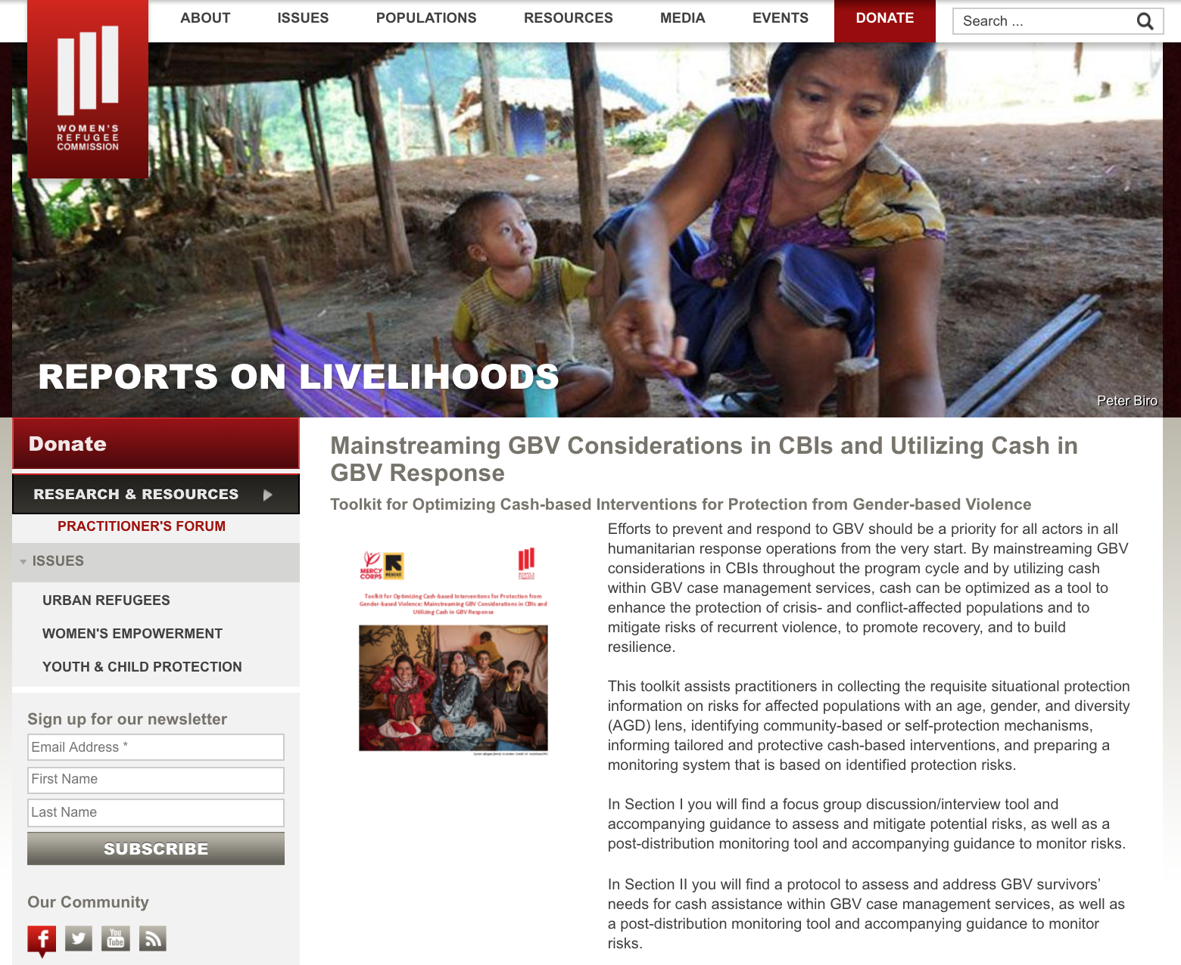
Resources: Toolkit & Video
http://wrc.ms/cashandgbv
Notes:
Toolkit for Optimizing Cash-based Interventions for Protection from Gender-based Violence can be downloaded from WRC’s website in English, Arabic and in editable format.
A short vide is also available which addresses the roles and responsibilities of cash and GBV actors in mainstreaming GBV considerations in CBIs and utilizing cash within GBV response.

Slide 29
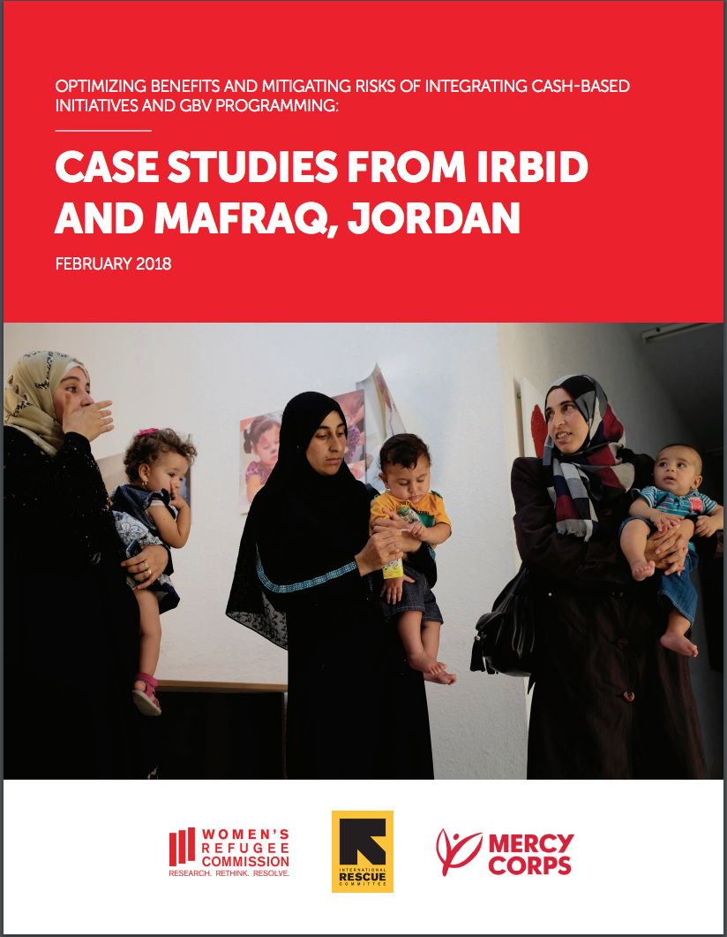
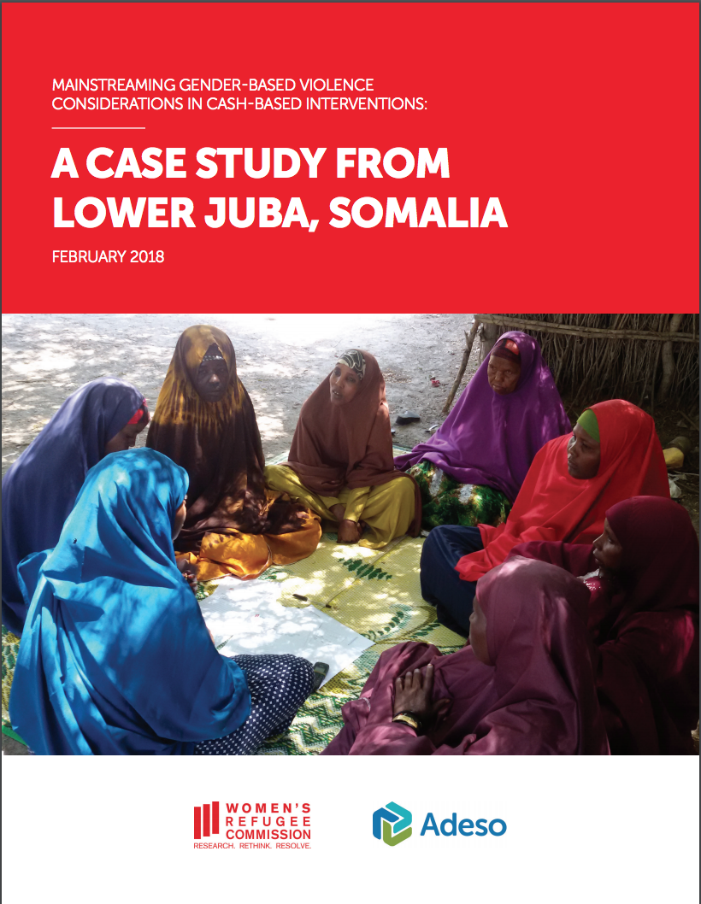
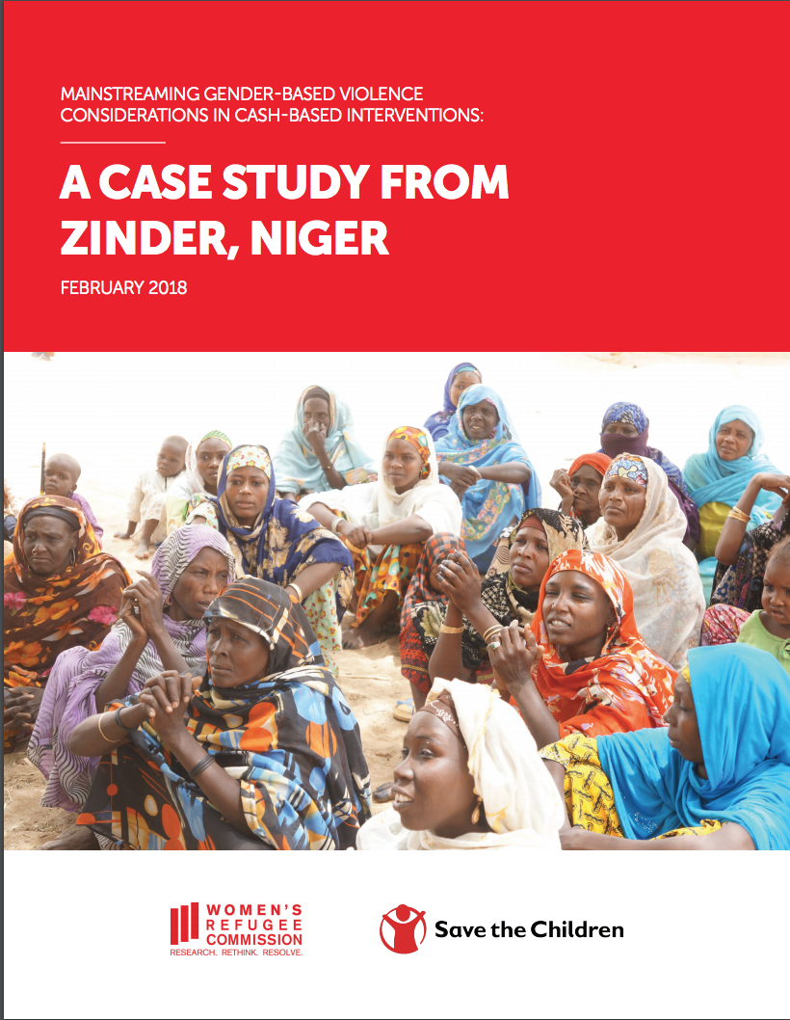
Resources: Case Studies
http://wrc.ms/cashandgbv
Notes:
Three case studies are available.
The first case study authored by WRC, IRC and MC which has been referenced today shares learning from piloting sections I and II of the toolkit within IRC and MC ongoing CBIs and GBV programming in Irbid and Mafraq, Jordan.
The second case study authored by WRC and African Development Solutions (Adeso’s) shares learning piloting section I tools to mainstream GBV considerations within Adeso’s cash-based intervention in Lower Juba, Somalia.
The third case study authored by WRC and Save the Children also shares learning from piloting section I tools within Save the Children’s CBI in Zinder, Niger.

Slide 30
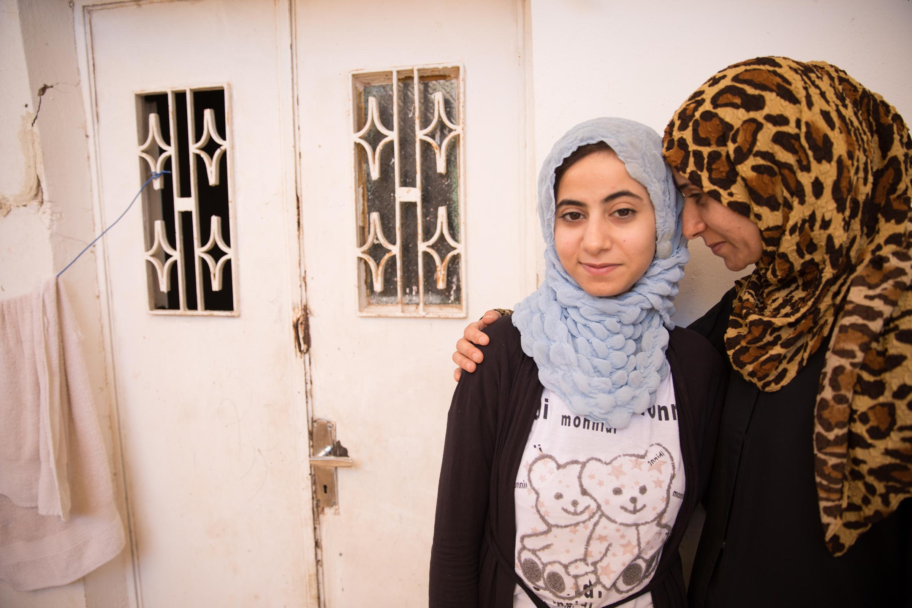
Q&A

Slide 31
Please contact us:
Thank you!
Tenzin Manell: tenzinm@wrcommission.org
Melanie Megevand: Melanie.Megevand@rescue.org
Kevin McNulty: kmcnulty@mercycorps.org

