Slide 1
5
Managing stress

Slide 2
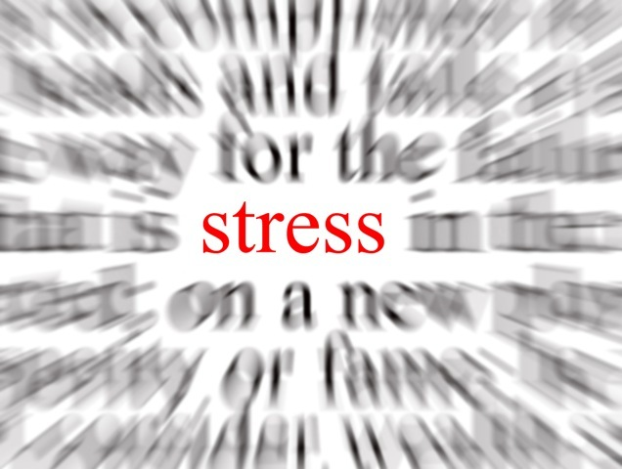
How do I know if I am stressed?

Slide 3
Stress
The stress response
The relaxation response
Floods the body with chemicals to prepare for fight or flight
Helpful in true emergency situations, to stay alert
Wears the body down when constantly activated.
Brings your system back into balance
Deepens breathing
Reduces stress hormones
Slows heart rate
Reduces blood pressure
Relaxes muscles.

Slide 4
Managing stress
There are three kinds of stress:
  day-to-day stress
  critical incident stress (e.g., shooting, assault, fire)
  cumulative stress.
If cumulative stress is not managed properly, service providers can experience burnout or vicarious trauma.
This can be damaging for the individual, and also for their clients, if it is not recognized and managed.

Slide 5
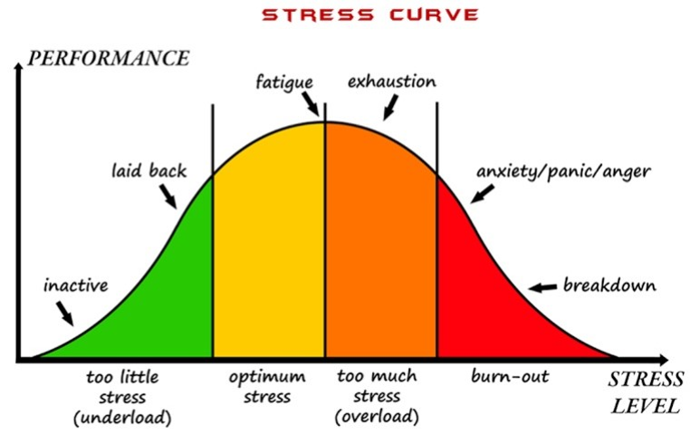
Stress

Slide 6
What is burnout?
Burnout is the result of chronic workplace stress that has not been managed successfully. It is characterized by:
  exhaustion or energy depletion
  feelings of negativity towards one's job
  reduced professional efficacy.
  Burnout is common among those who work with people in distress.

Slide 7
Stress and burnout
Stress | Burnout
Over-engagement | Disengagement
Emotions are over-reactive | Emotions are blunted
Urgency, hyperactivity | Helplessness, hopelessness
Loss of energy | Loss of motivation, ideals and hope
Leads to anxiety disorders | Leads to detachment and depression
Primary damage is physical | Primary damage is emotional
May kill you prematurely | May make it seem that life is not worth living

Slide 8
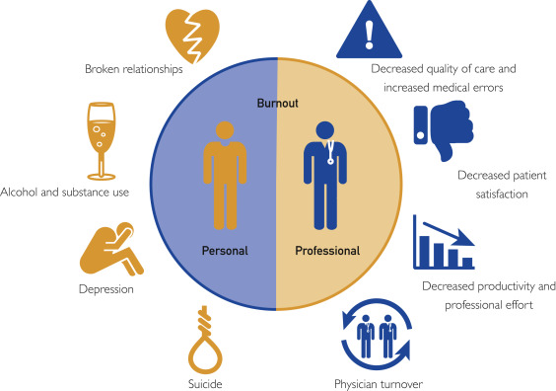
The consequences of burnout

Slide 9
Caring for the carers
“Helping clients deal with physical abuse, sexual abuse, or HIV infection is emotionally draining. Issues that surface during counselling sessions may address painful or unresolved experiences of the counsellor. Counsellors often experience emotional burnout, depression, and difficulties in their own relationships.”
(Southern African AIDS Training Program, Counselling Guidelines on Domestic Violence, SAT, 2001, p. 21).

Slide 10
Vicarious trauma
Sometimes called secondary trauma or compassion fatigue
Involves absorbing clients’ trauma
Sufferers may re-experience difficult or traumatic events from their own past
A process that unfolds over time – it is not a response to one person, story or situation
Is the cumulative effect of contact with survivors of violence, trauma and loss.

Slide 11
Vicarious trauma: Impacts
Persistently tense, upset or worried
Job performance goes down, mistakes go up
Morale drops
Personal relationships are affected – home life may start to deteriorate
Can lead to overall decline in general health
Changes in spirituality – hopelessness, loss of faith.

Slide 12

Recognizing signs of cumulative stress
Each individual experiences stress differently.
Have you observed any signs of cumulative stress in yourself or others?

Slide 13
Know your warning signs
Increased anxiety or edginess
Easily angered by minor events, or feeling anger towards a lot of people and/or institutions
Increased feelings of depression
Hopelessness: feelings that no progress will ever be made
Frustration with specific clients or GBV/SVAMB work in general
Avoidance of social situations
Increased fatigue
Feelings of heightened responsibility for the well-being of clients.
Feelings of insufficiency.
Working more hours than those required of you

Slide 14
Know your warning signs
Feeling indifferent towards clients and the issue of GBV/SVAMB
The absence of supervision and debriefing
Inexplicable physical problems, such as tense muscles, persistent stomach aches or headaches, etc.
Feelings of isolation: the sense that no one understands what you are experiencing
Feeling guilty for being happy or for not having experienced GBV/SVAMB
Nightmares about GBV/SVAMB
Internalizing stories and being convinced that similar experiences will happen to you.
Feeling overwhelmed by destructive or dangerous experiences (such as a suicidal client or staff assaults)

Slide 15
Emotional response
 | Emotional response |  | What you can do
 | Survivor | LCM | For survivor | For yourself
Fear | Of rejection or hurt. Of injury or being killed. | Of what might happen to you. Of getting hurt. | Listen, safety plan, alert supervisors. | Establish safety procedures, talk with your organization about your fears.
Denial | Of severity or even the problem. | Of severity. | It is a defence, continue to encourage to seek help. | Find someone to talk to, process it.
Over-whelmed | Lack of options and resources. | Lack of options or resources for client. | Help to find support network of others. | Establish realistic goals, check expectations, mobilize support networks, talk to supervisor.
Discouraged | Tired of no one caring. | Can't do ANYTHING for survivor. | Understand significance of even small steps. | Know your resources, share concerns with others.

Slide 16
Know your needs
Each LCM should evaluate what they need in their lives in order to cope with their job.

Slide 17
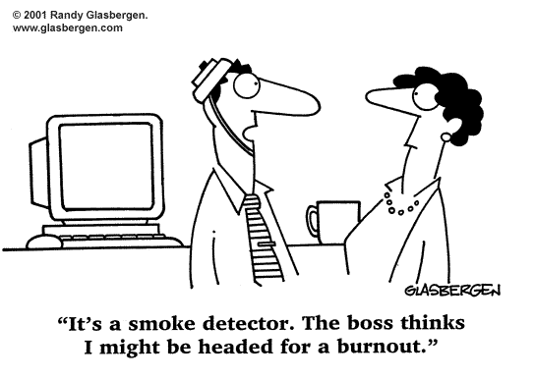
Brainstorm
What are your signs that you are getting
stressed and need a break?
What do you know you need to have in your
life in order to cope with stress?

Slide 18
Stress management
Stress reduction
Module 5

Slide 19
Basic stress management
To maintain well-being, the body needs regular, good quality:
  Exercise
  Nutrition
  Rest and sleep
  Relaxation
Emotional, spiritual and intellectual self-care are also important

Slide 20
What more can we do for ourselves?
Escape! Rest! Play!
Do things that you enjoy and that relax you.
Talk to friends.
Ask your friends to notice how you’re doing.
Debrief with staff/peers about particularly difficult cases, events or situations.
Work to transform it – vicarious transformation.

Slide 21
Recap
If cumulative stress is not managed properly, service providers can experience burnout or vicarious trauma.
Each individual experiences stress differently, and it is important to recognize signs of cumulative stress.
Basic stress management involves taking care of your body and mind. Paying attention to your physical health by eating right, getting enough sleep and exercising are also important.
Escape, rest and play are three ways to manage stress and promote relaxation.

Slide 22
Ways to manage stress at work:
Supervision
Module 5

Slide 23
Supervision
Is the key strategy to ensure that staff are coping professionally and personally with their work. It is important for continued staff capacity development and to ensure quality of care.
Can be provided through different approaches, including through one-on-one support, in groups, through on-the-job observation and coaching, and in regular team meetings.
Can take multiple forms and can vary between countries.
In the European context, we usually distinguish between:
Internal supervision
External supervision

Slide 24
Internal supervision
Occurs between the supervisor and supervisee within an organization where, commonly, the supervisor is also the manager or team leader and holds organizational accountabilities for the supervisee’s practice.
Commonly defined as 'line management'.
Is the most traditional form of supervision.

Slide 25
External supervision
Takes place between a senior professional and a staff member who do not work for the same organization.
Usually takes place outside of the staff member’s place of work.
Helps the staff member deal with work-related stress and conflict, workload management and work-life balance.
Communication is key in effective external supervision.
This means making sure that the people who provide the service get support with their own problems and feelings!

Slide 26
External supervision is a process
External supervision aims to:
provide an opportunity to discuss practices to ensure quality service to clients
provide a space to share experiences and to debrief
ensure that staff do not become overwhelmed by their work emotionally
monitor and manage stress
give listeners the opportunity to be talkers.

Slide 27
External supervision can include:
individual discussions with a staff member: asking questions, listening, observing, advising, teaching, coaching, and mentoring
facilitated debriefing sessions weekly or after particularly difficult or frustrating cases
regular scheduled meetings that include informal discussions and continuing education
specific and enforced policies and procedures that ensure staff security and set professional boundaries
facilitated activities with staff that are simply fun and relaxing
providing feedback for staff on their work performance, focusing in particular on their strengths and achievements.

Slide 28
Peer supervision
is an effective form of supervision
provides staff with the opportunity to talk with each other about their work, to reflect on their work, and to share information, experiences and problems
provides a space where service providers (and others) can listen to each other and give valuable feedback about their work-related challenges and effective strategies to overcome them
should be a supportive learning and sharing experience.

Slide 29
Peer supervision: For managers (and others)
Pay attention to staff, peers, colleagues, partners – notice how people are doing.
Ensure clear roles and responsibilities of all staff – including limitations.
Enforce policies and procedures for professional boundaries – and support staff in keeping within these boundaries.
Make sure people use their time off.
Consider virtual supervision for informal teams and peers through text messaging, chat groups or other forms of communication.

Slide 30
Exercise
Actions to take during the coming months

Slide 31
Recap
Supervision helps staff to cope professionally and personally with their work.
There are different forms of supervision, including external and internal supervision, as well as peer supervision and virtual supervision.
LCMs can ask for supervision sessions to debrief, they can form work teams to manage stress, and they can collaborate with peers who are not in their organizations to provide debriefing and stress management.

